Slide 1
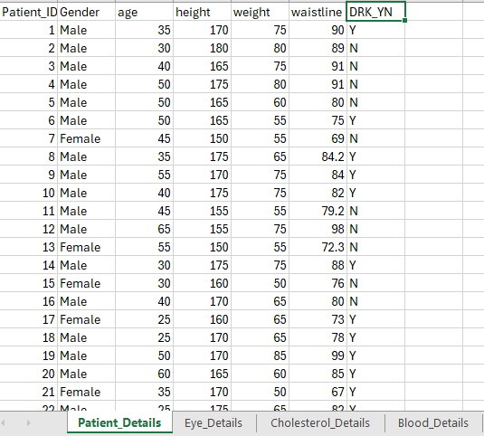

Data Set
Data set consits of Patient details,
Impact on vision due to smoking and drinking
impact on cholesterol level
Also the impact on Blood level.

Slide 2
New measurements created in Dataset
Age Group =
IF('Patient_Details'[age] < 30, "Young Adult",
IF('Patient_Details'[age] < 60, "Middle-aged",
"Elderly"
)
)
BP_Status =
VAR Max_SBP = MAX('Cholesterol_Details'[SBP])
VAR Max_DBP = MAX('Cholesterol_Details'[DBP])
VAR High_SBP_Threshold = 130
VAR Low_SBP_Threshold = 90
VAR High_DBP_Threshold = 90
VAR Low_DBP_Threshold = 60
RETURN
SWITCH(
TRUE(),
Max_SBP >= High_SBP_Threshold || Max_DBP >= High_DBP_Threshold, "High",
Max_SBP <= Low_SBP_Threshold || Max_DBP <= Low_DBP_Threshold, "Low",
"Normal"
)

Slide 3
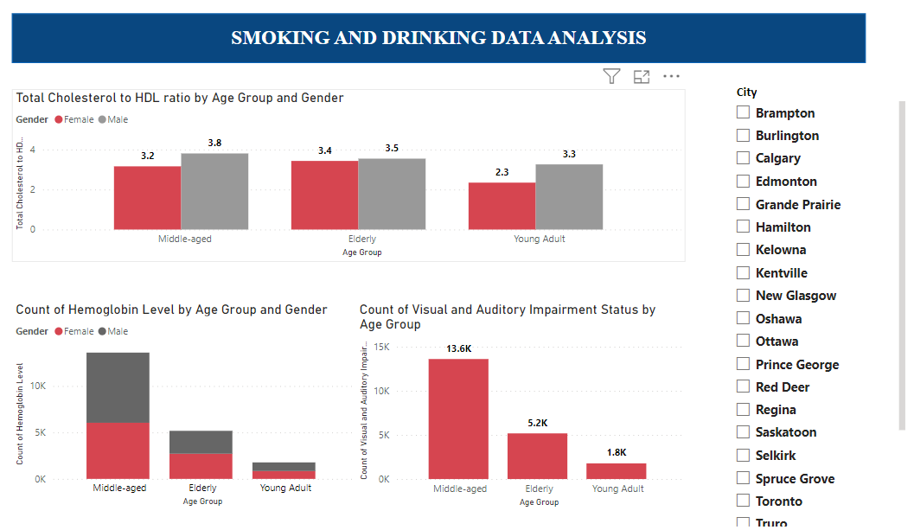
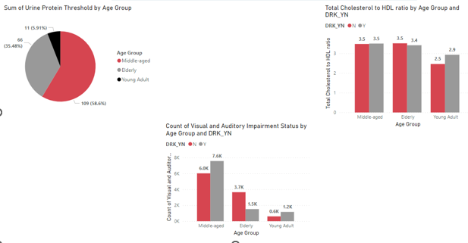
Appendix

Slide 4
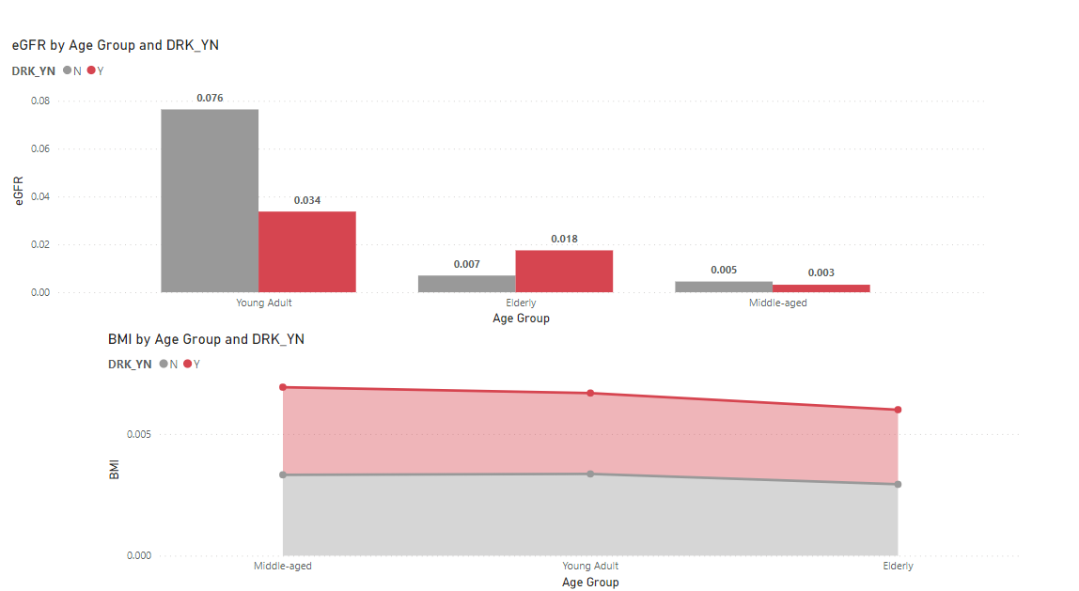
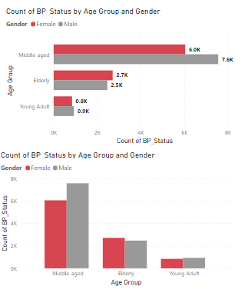

Slide 5

Questions that can be answered using the dataset
How do motivations for Smoking and Drinking cessation vary across different age groups?
What are the most effective intervention strategies for each age demographic?
How do external factors such as social influence, health knowledge, and economic status impact Smoking and Drinking cessation behaviors within each age group?

Slide 6

Findings
Renal Health Dynamics Across Age Groups:
Cardiovascular Advantages of Smoking and Drinking Cessation:
Sensory Health Disparities in Non-Smokers:
The analysis reveals significant correlations between lifestyle factors, such as smoking and alcohol consumption.

Slide 7

THANK YOU

